Slide 1
CIS545 Final Project: Sarcasm Detection
Jonathan Shaw , Zihu Xu

Slide 2
Introduction
Sarcasm plays a huge role in our daily lives, it completely flips the meaning of a sentence, which would have huge implications on NLPs such as sentiment analysis. Therefore, our team decided to train a sarcasm detection model based on reddit comments.

Slide 3
Data
https://www.kaggle.com/danofer/sarcasm?select=train-balanced-sarcasm.csv
This Data Set is about sarcastic comments on Reddit. These comments are identified by the users who post them by tagging them with /s. This tag is used by redditors to indicate to others that their comments are not to be taken seriously.
This is a perfect data set for NLP learning, because of its size(1.3 million posts) and because of the labels from redditors to easily identify sarcastic comments. The /s has already been preprocessed to be labeled(0/1) in the sarcasm column.

Slide 4
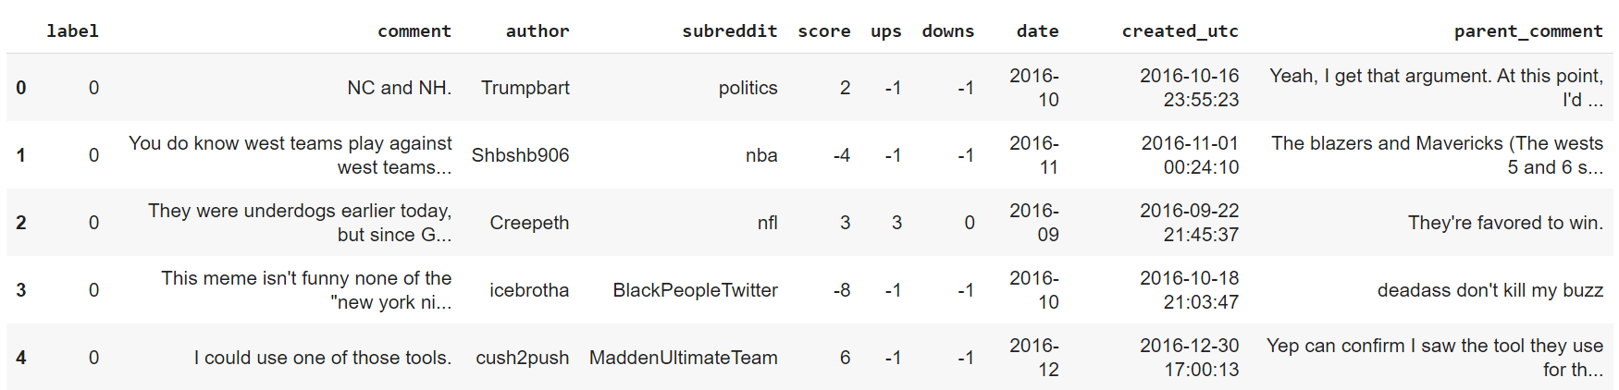
Data Visualization

Slide 5
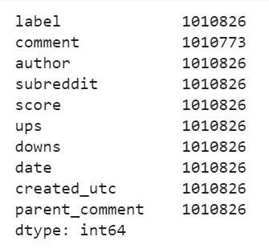
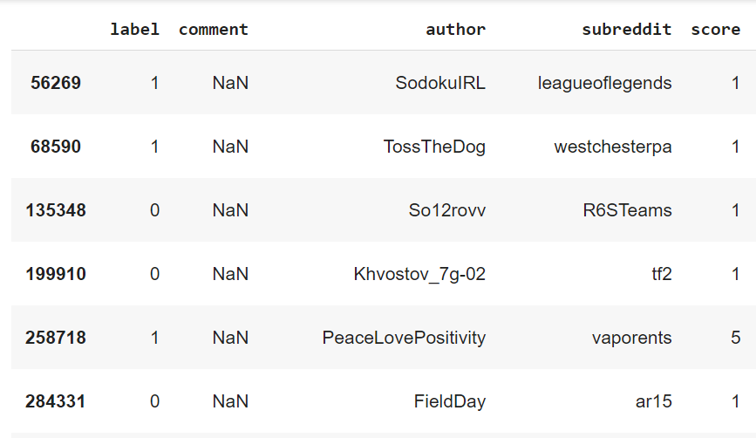
Drop Null Data
These rows are a little bit annoying because their comment contains null value.We can drop these rows since we can ignore 53 rows compared to 1.3 million rows.

Slide 6
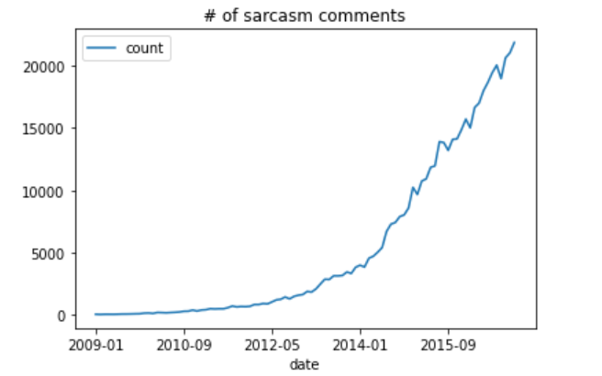
Data Exploration
Initially,we analyzed the change of sarcasm comments along the time and found the early data volume is too small. Then we proposed a guess that it's because at that time, many comments which are supposed to be sarcasm but failed to be truly classified.

Slide 7
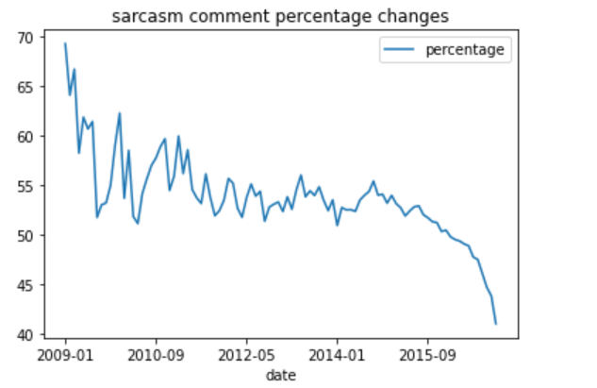
Data Exploration
However, after we calculate the percentage of sarcasm comments along the time, we find it important to keep. And actually, the percentage of sarcasm comments decreases as time passes.

Slide 8
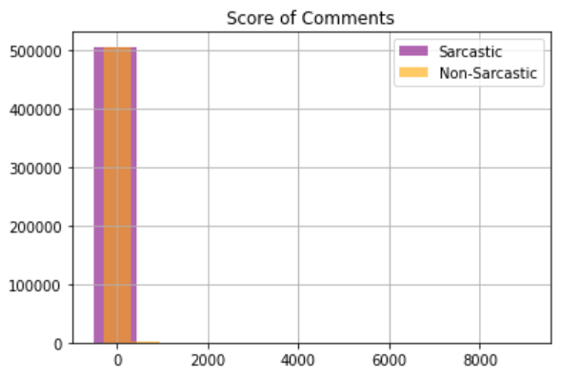
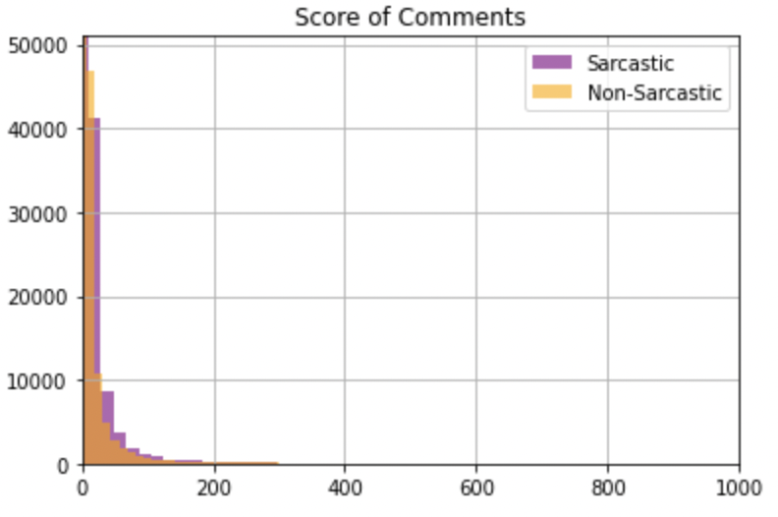
Feature-Score
Firstly,we hope to visualize the score effects on both sarcasm and nonsarcasm comments to find whether there is any difference. However, when we try to directly use the score. The data is so dense. So we look for log.

Slide 9
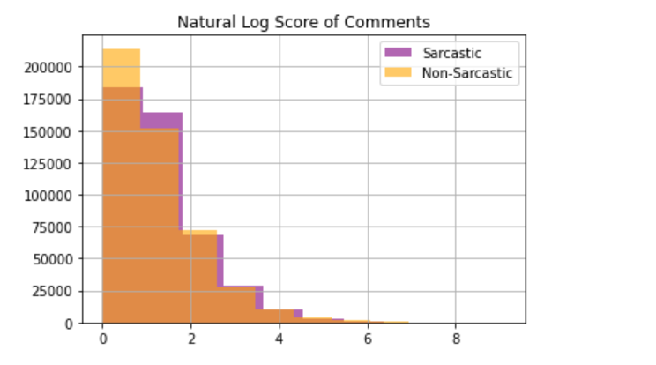
Log_Score
Since the dataset is balanced.It's not necessary to calculate the percentage to compare. According to the graph, we can find that there is a higher chance for non-sarcastic comments appear in the low score area.

Slide 10
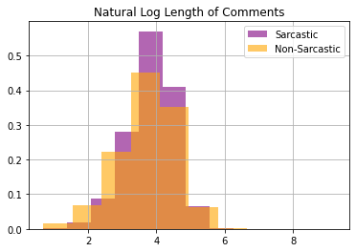
Log_Length
With the similar idea with log_score, we hope to explore the difference between the length of comments for both sarcasm and non-sarcasm. Based on our finding, we can see sarcastic comments to be more concentrated. Non-sarcastic comments tend to be a little bit longer.
Based on that, we will use log_length as a new feature to train our model.

Slide 11
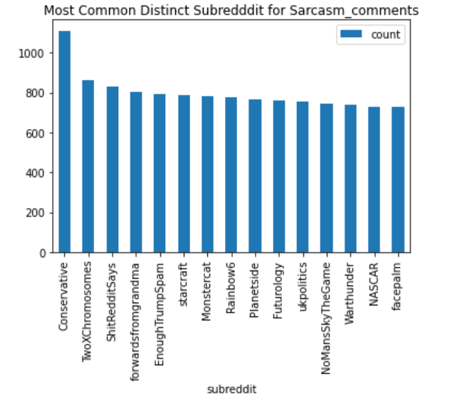
It's quite interesting that Conservative and TrumpSpam ranks so high in distinct subreddit for sarcasm comments.They do not show up in top100 nonsarcasm comments. Perhaps users in Reddit tend to have a political preferrence to be against to Conservative Party. Furthermore, we can find that the subreddit tends to be more complex and the length tends to be longer for sarcasm comments.

Slide 12
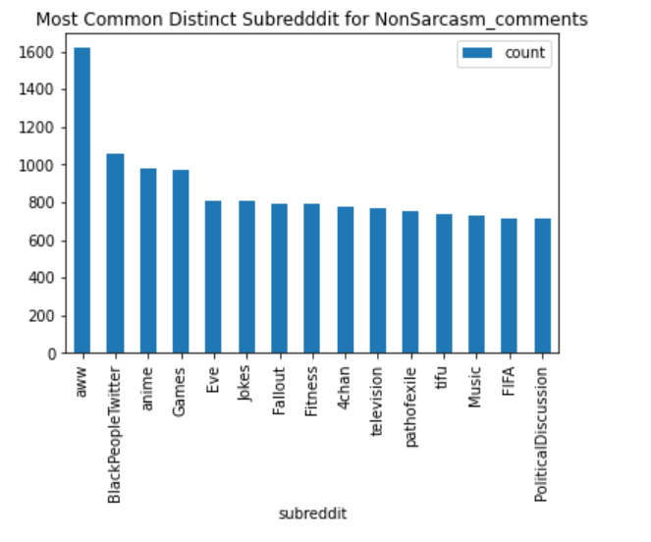
Compared to distinct sarcasm comments’ subreddit, we can find that the distinct non-sarcasm comments’ subreddit tend to be shorter.And the subreddits here tend to be more ordinary such as games,television or music.

Slide 13
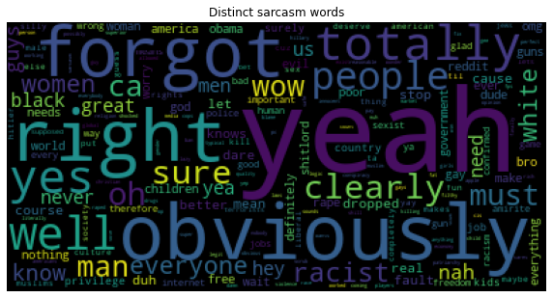
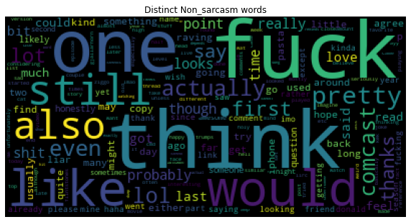
Word Cloud Comparison

Slide 14
Data Processing
Removing NA values
Made words lowercase
Removed punctuation from sentence
TF-IDF

Slide 15
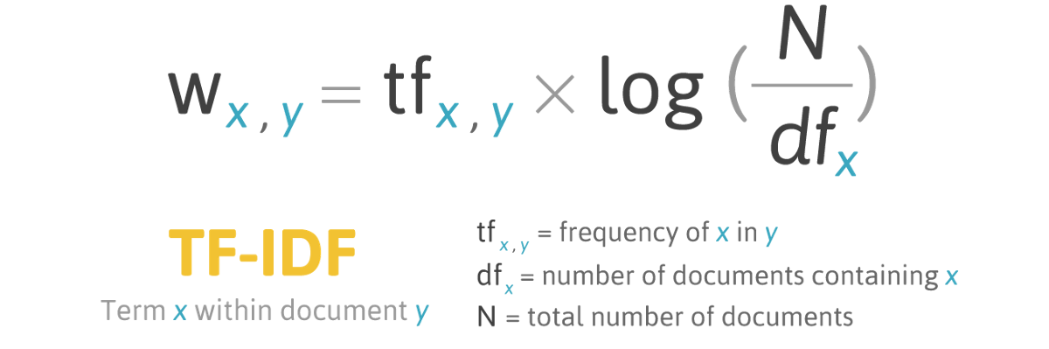
Comment Transformation
TfidfVectorizer Model
Considers both number of times a word appears within single comment, but also overall occurrence through all comments.
Parameters
stop_words=stopwords, max_df=0.95, max_features=50000, min_df=0, ngram_range=(1,2)

Slide 16
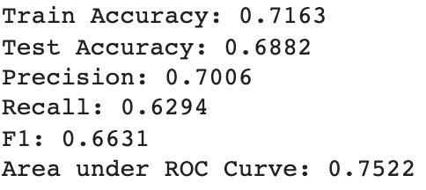
Baseline Model
By using simple logistic regression we were able to get a f1 score of 0.663, training accuracy and test accuracy were 0.7163 and 0.6882 respectively, both low.
Randomforest didn’t generate good results either, with a 0.6360 training accuracy

Slide 17
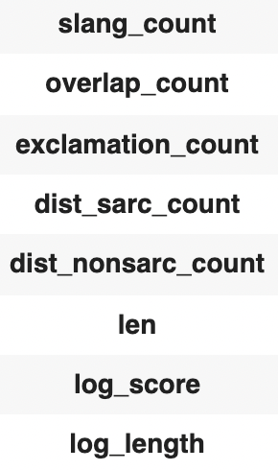
Feature Extraction
Based on EDA, we decided to extract several features to improve the model accuracy. We looked at the correlation matrix to determine use of it.

Slide 18
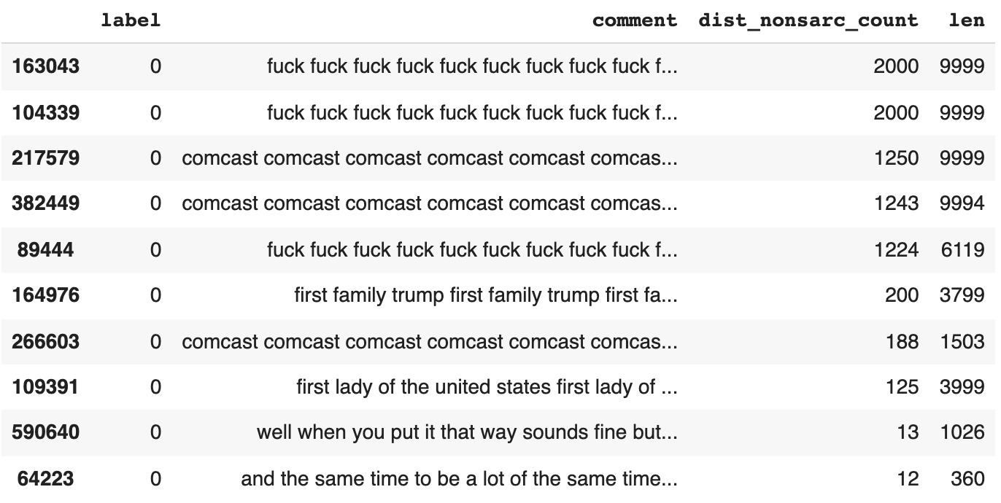
Removing Dirty Data
During feature extraction, we realized that some comments were repetitive phrase, which significantly increased certain word counts, thus we removed them.

Slide 19
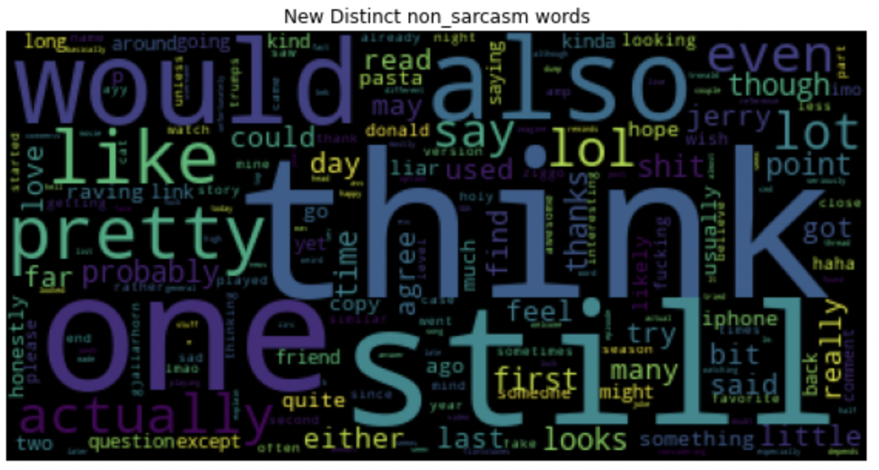
Word Cloud Comparison

Slide 20
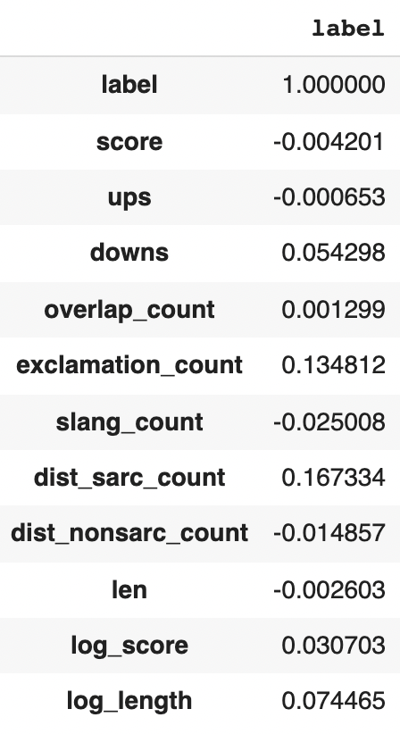
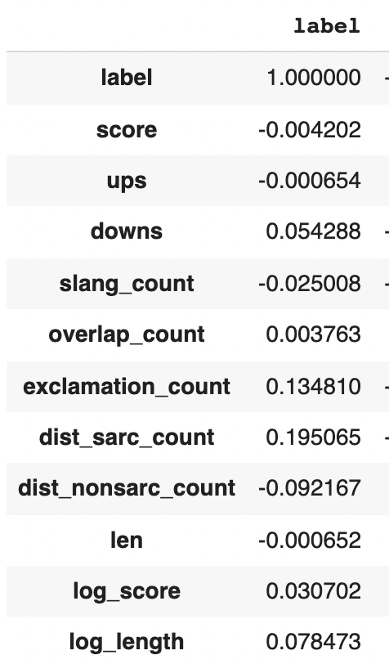
Correlation Matrix Comparison
As you can see, the correlation matrix for dist_nonsarc_count and dist_sarc_count increased significantly

Slide 21
Features to Add
Upon testing features with high correlation (exclamation_count, dist_nonsarc_count, dist_sarc_count, log_len), we concluded that exclamation_count was the only one improving the model, which made sense, from the models view all punctuations were removed. From realistic view someone being sarcastic is bound to be acting more dramatic by adding more exclamation marks.
Some reasons dist_nonsarc_count, dist_sarc_count, and log_len failed might be because they are highly correlated with sarcasm but also with comment matrix, therefore creating multicollinearity and overfit issue.

Slide 22
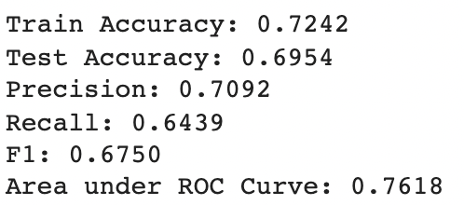
Improved Model #1
All model scores were up just by adding exclamation mark count and removing the dirty data. All metrics are up from before.

Slide 23
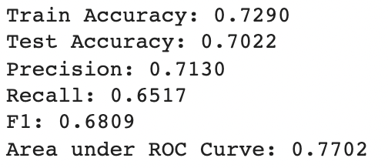
Final Model with Subreddit Feature
During EDA we also found subreddit being highly correlated with sarcasm, so we decided to perform TfidfVectorizer on subreddit names too. After adding 10,000 features of subreddit tf-idf vectors, model improved again, with test accuracy reaching 70% for the first time

Slide 24
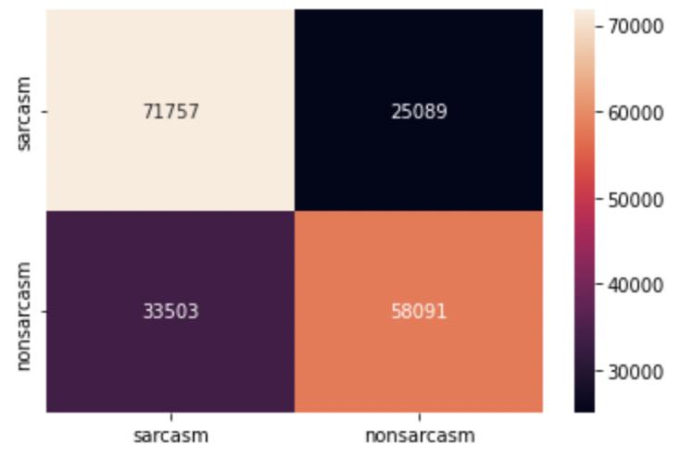
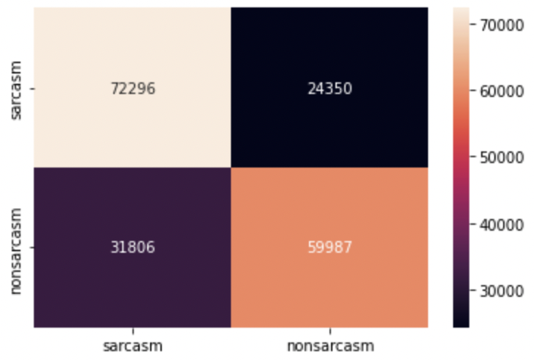
Model Analysis
Baseline Confusion Matrix
Final Confusion Matrix

Slide 25
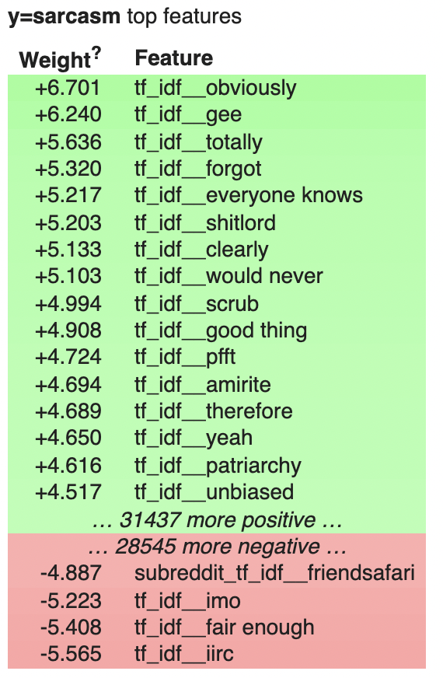
Model Weights

Slide 26
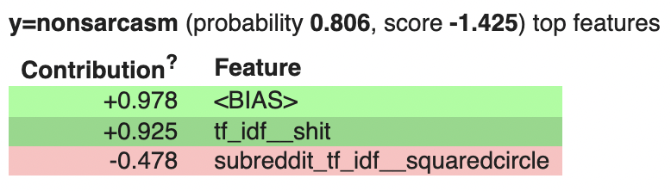
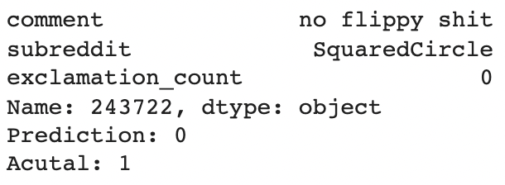
Looking at some Misclassified Examples
False Negative
“no” removed as stopword
“flippy” didn’t occur enough to be included as a feature

Slide 27
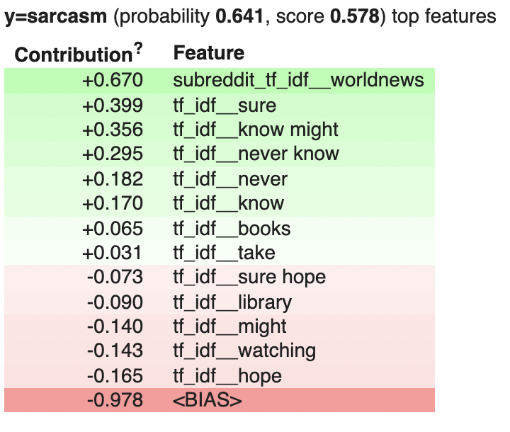
False Positive
Heavily affected by subreddit
Too many words and combination was also affecting model performance

Slide 28
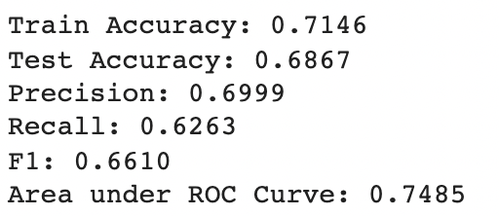
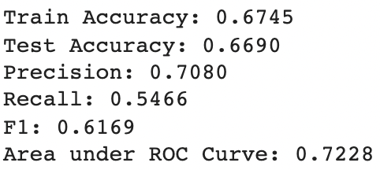
Failed attempts
Through the model enhancing process we failed several times. Similar to removing stopwords, we tried to remove the most overlapped words in sarcasm and non-sarcasm comments, but this only decreased the model accuracy.
Model Boosting based on decision tree was also unsuccessful, although it was improved compared to previous Random Forest Model.
Remove Overlap Words Results
Decision Tree Boosting Results

Slide 29
Challenge
The models yield a low test accuracy score(68.8%), so we had to try a lot of different methods to improve the model, many of which failed and actually decrease the accuracy.
Finding the right parameter and transformer for comments also took some effort

Slide 30
Next Step
We now have a model that can detect sarcasm more accurately. We can use this model to augment other NLP supervised learning model.
Model can be further improved by adding features similar to Exclamation Count.

